Slide 1

FUS Sample Testing
January 2012
Calibration Meeting
Julianne Heinzinger

Slide 2
FUS Sample Testing
Overview
Responsibilities
Follow-Up on Samples Not Received
Creating Datasheets
Testing
Reporting Results

Slide 3

FUS Sample Testing
Why
Integrity of mark
Typically used on continuous process type construction
Revenue
Charge for most tests

Slide 4
FUS Sample Testing

Slide 5
FUS Sample Testing

Slide 6
2011 FUS Sample Testing Industries

Slide 7

FUS Sample Testing Process
Select Sample
Manufacturer Sends Sample
Sample Arrives
Create Datasheets
Test
Report Results

Slide 8

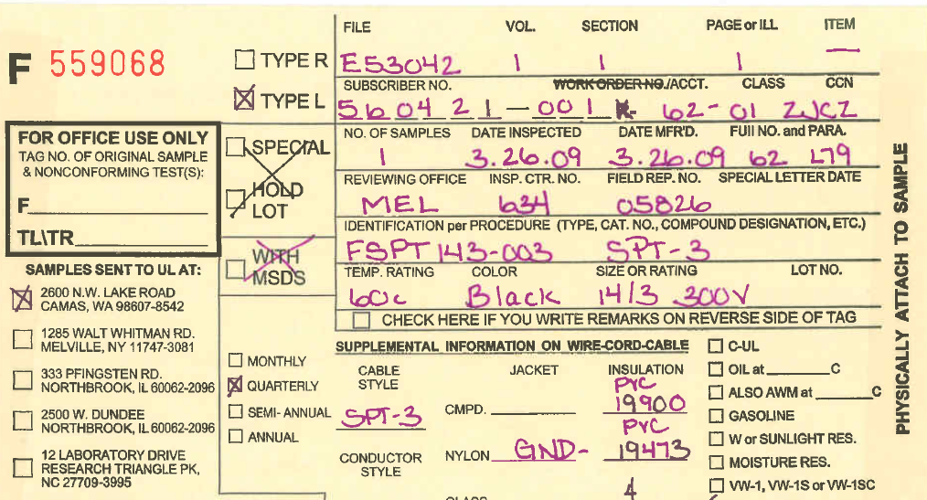
FUS Sample Testing
Types of samples
C = Field Report
L = Hold Lot (W&C Only)
M = Market Survey
P = Power Cords
R = Regular
S = Special
X = Decorative Lighting Strings
Red are the types covered in the SOP 00-LO-S0026

Slide 9

FUS Sample Testing
Specific FUS Sample Testing SOPs
00-LO-S0026 Follow-Up Services (FUS) Sample Testing Standard Operating Procedure
00-CA-W0031 FUS Sample Testing TP3 Billing Instructions for Tag with Nonconformance Results (Contact)
00-LO-W0027 Following Up on Un-Received FUS Samples
00-UM-S0027 UM, Sample Selection and Preparation Procedure

Slide 10
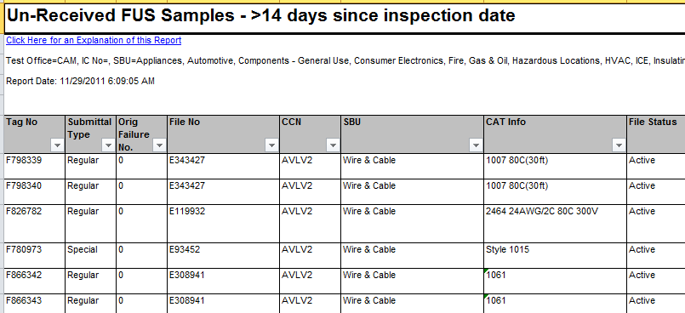
FUS Sample Testing
Samples Not Received
DataMart Report
FCM
00-LO-W0027
Each office handles differently
Find out how being done
Who keeps the records
How do they know

Slide 11
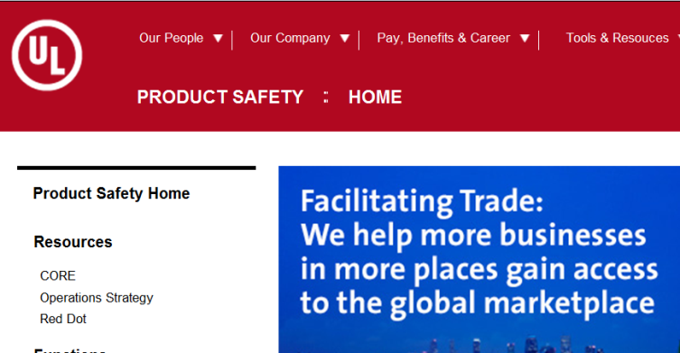
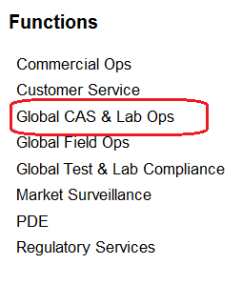
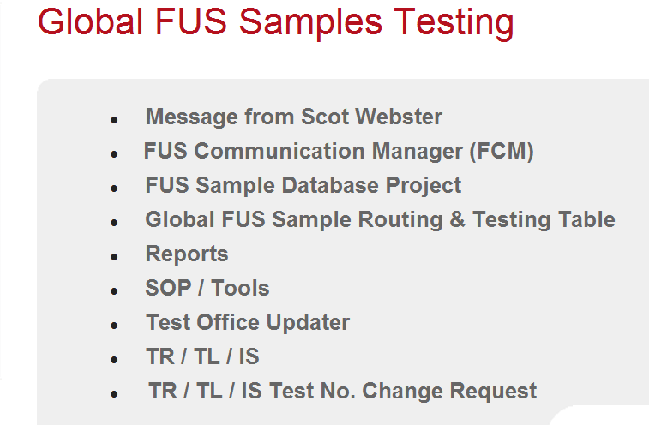
FUS Sample Testing
Un-Received Report Location
Bookmark It when you find it
Product Safety Home page from Intranet
Global CAS and Labs Ops
FUS Sample Testing
Reports
Un-Received Report

Slide 12
FUS Sample Testing
Un-Received Sample report
Shows how long since inspection it has been that samples have not been received
Should be used by all locations
Use it to check if reminder letters have been sent

Slide 13
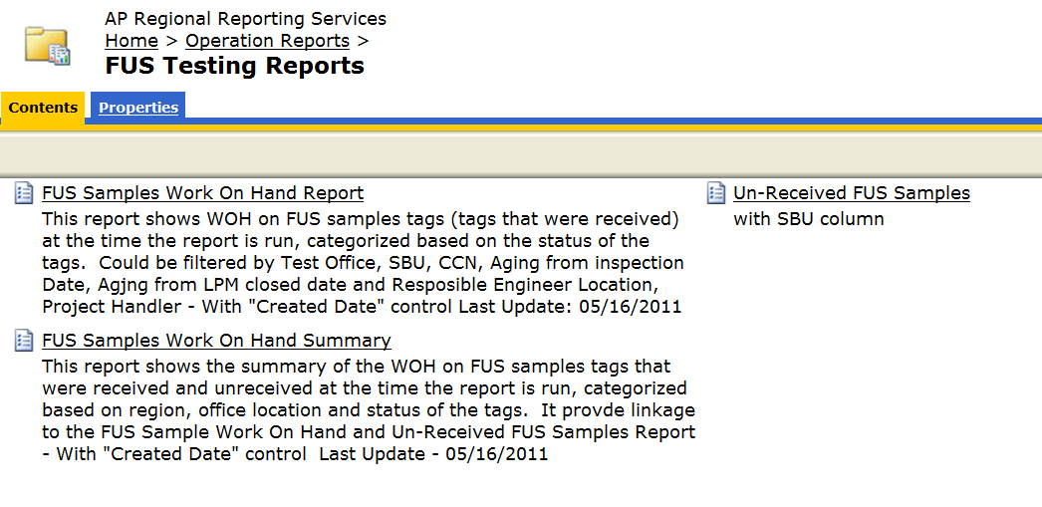
FUS Sample Testing
Other Datamart Reports

Slide 14
Demo Un-Received Report

Slide 15
FUS Sample Testing
Creating datasheets
Criteria from Appendix pages
Plastics program
FUS Sample Database
Obtain Criteria
Get DS
Complete DS

Slide 16
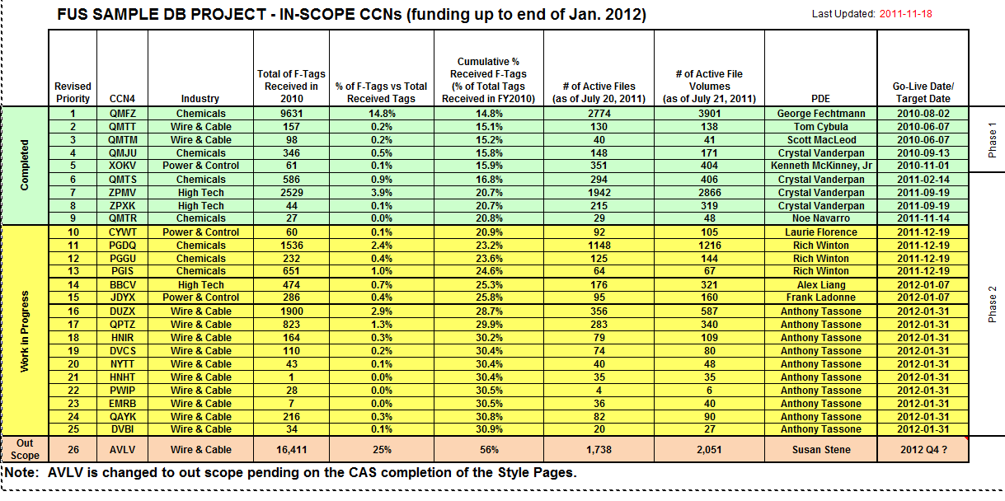

Slide 17
Demo SAP
&
FUS Database

Slide 18
FUS Sample Testing
Creating datasheets
Data Sheets
00-LC-S0258 applies
00-LO-S0026 applies
Datasheets need to be in Document Control
Obtain Criteria
Get DS
Complete DS

Slide 19
FUS Sample Testing
Creating datasheets
Complete
Cover page, sample number, model, etc.
Temperatures needed
Other needed information for testing
Obtain Criteria
Get DS
Complete DS

Slide 20
FUS Sample Testing
Laboratory Requirements
Same as required for New work in completion of data sheets
Some hard copy
Most electronic

Slide 21
FUS Sample Testing
Passing
No review required
No copy of letter to the field rep
Failure
L3 review required
TP3
where all your answers are
U150 & U151 main screens to use

Slide 22
FUS Sample Testing
Closing in TP3
Which tests were conducted
TL TR Charges
List on AP FUS Page
Pass / Fail / No Test
FCM pulls information from TP3

Slide 23

FUS Sample Testing
PASSING RESULTS
Close in TP3
Letter
File

Slide 24


FUS Sample Testing
FAILING RESULTS – L3 Review Required
Close in TP3
Letter & File
Track New Sample

Slide 25
FUS Sample Testing
NO TESTING
Incorrect sample
Duplicate sample
Sample too old
Close in TP3
Letter & File
Track replacement

Slide 26
Demo TP3

Slide 27
FUS Sample Testing
Older than 90 days
Okay for long term (30 days) testing
Okay for plastics
Need Engineering Manager approval for any other situation
Work on Hand Report - datamart

Slide 28
FUS Sample Testing
Inspection History Database
Records tag number
Can be useful when searching for samples by a file

Slide 29
Databases
DMS
FCM
Inspection History, Notes Database
Plastics
ePublisher
Datamart
FUS Sample Testing Database
LIMS
TP3
LPM
OBI – FUS Sample look-up
Technical Competency
eCommunications

Slide 30

What to look for – Desk Audit
Sample disposition
LIMS
Correct datasheets
Same criteria as new work 00-LC--S0258
Logged into LPM
Check meter use
Laboratory
Competence
Same recording requirements as New Work
TP3
Transferred correctly, when applicable (input department correct)
Authorization in comments section

Slide 31
Demo LIMS

Slide 32


Special Categories
Plastics
Plastics Database
Longer lead time (need to mold the bars)
Some automated processes for all
Identification, storage varies
W&C
Optional marking
Failure, special, hold lot
Monthly, Quarterly, Annual samples – different testing

Slide 33
FUS Sample Testing
Common things missed
Authorized Datasheet
Tracking of samples (not received, or failure, or replacement)
Letter for every sample – no test often missed
Sample disposition in LIMS
FUTURE ENHANCEMENTS
UPS Pilot Program
FCM automatically send passing letters (80%)

Slide 34

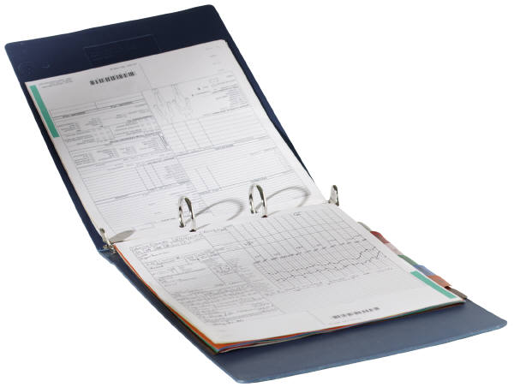

Records
All Tags require a closing letter to be stored in DMS
Datasheets (expect ID lab) to be stored in DMS
Un-Received request letters in DMS
Other correspondence in eCom
TP3 contains data not found elsewhere

Slide 35
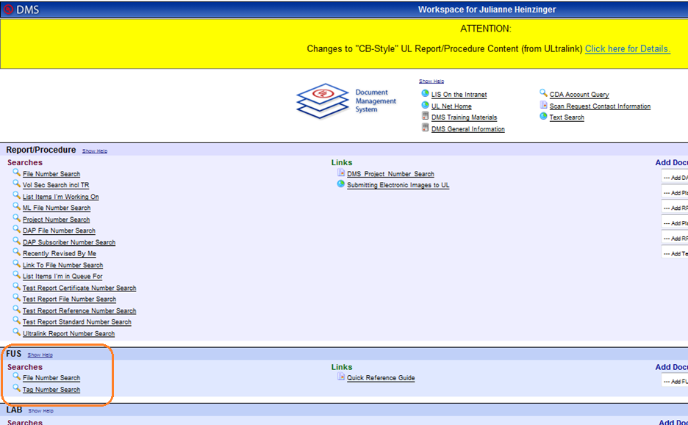

Slide 36
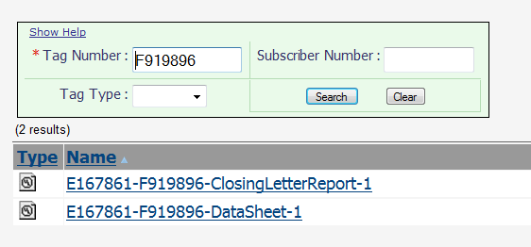
FINDING INFORMATION IN DMS

Slide 37
Questions ?

